Slide 1
Basic CPU

Slide 2
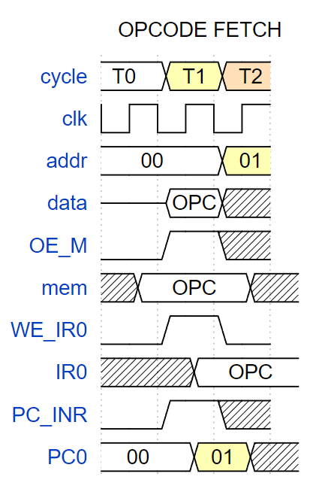
Instruction fetch

Slide 3
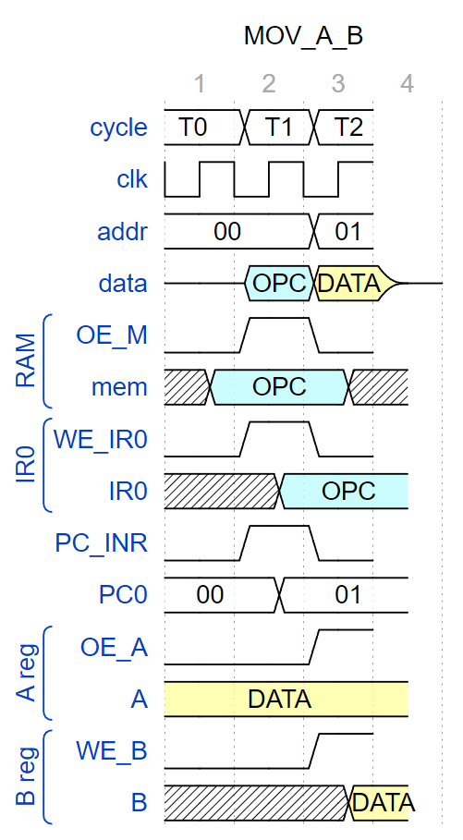
MOV_A_B

Slide 4
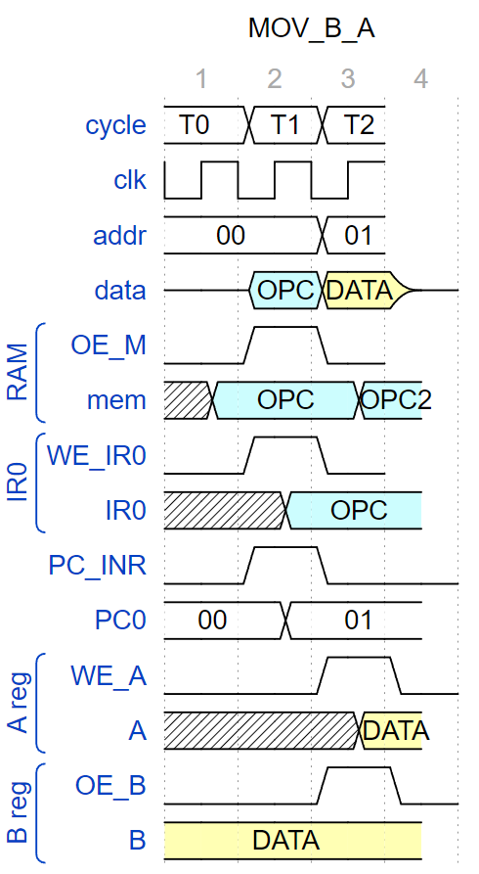
MOV_B_A

Slide 5
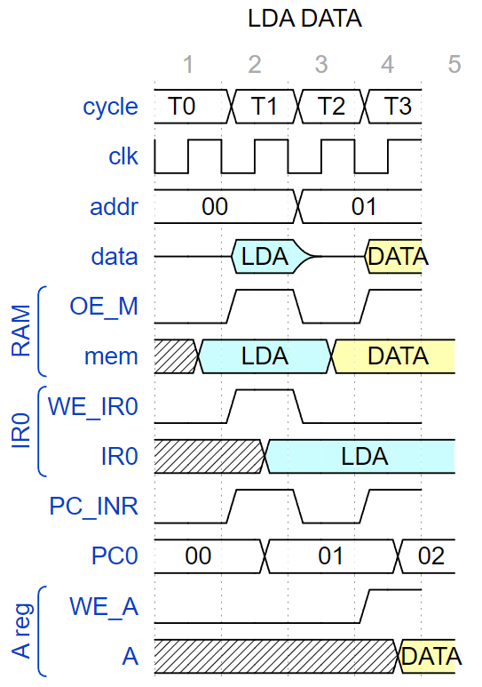
MVI

Slide 6
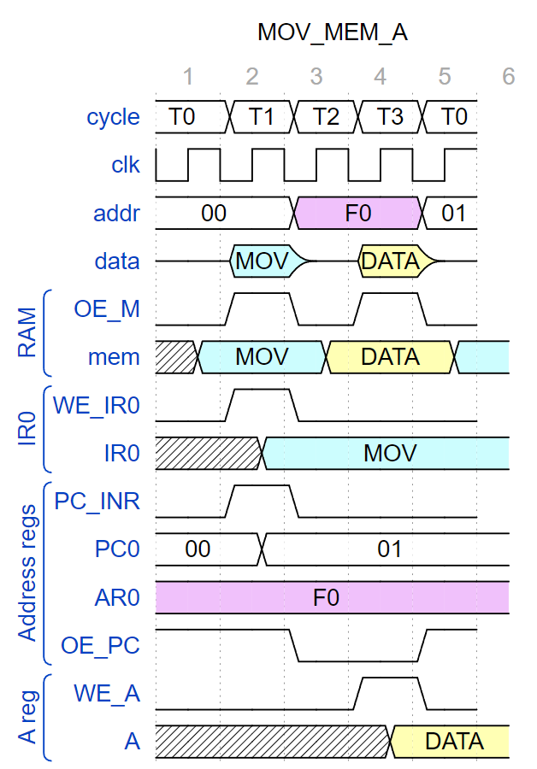
MOV_MEM_A: Memory Read

Slide 7
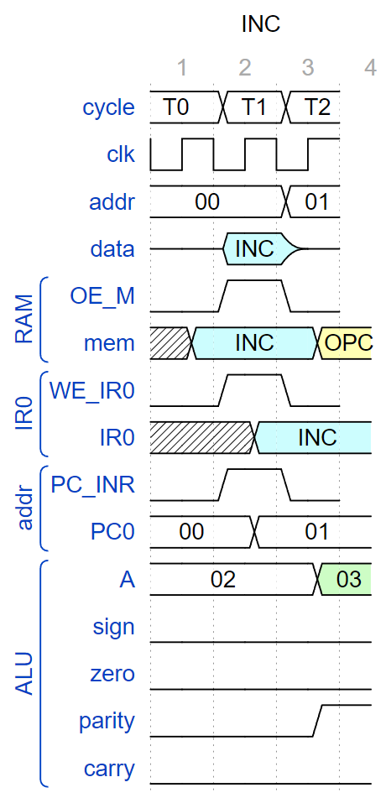
ALU:

Slide 8
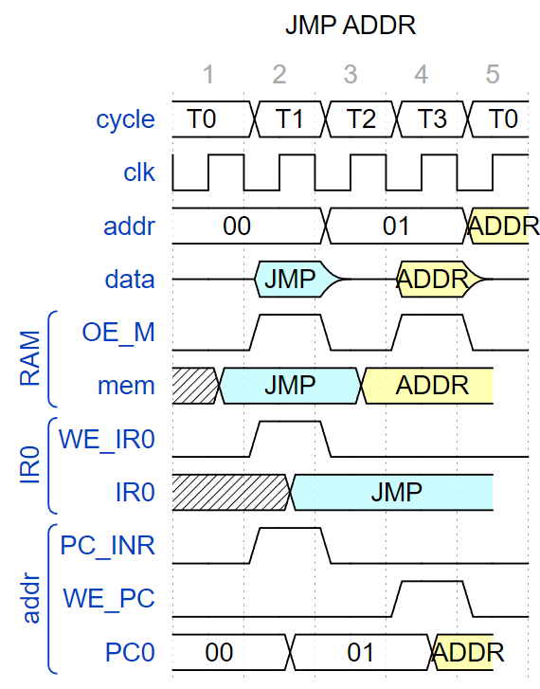
JMP UNCONDITIONAL:

Slide 9
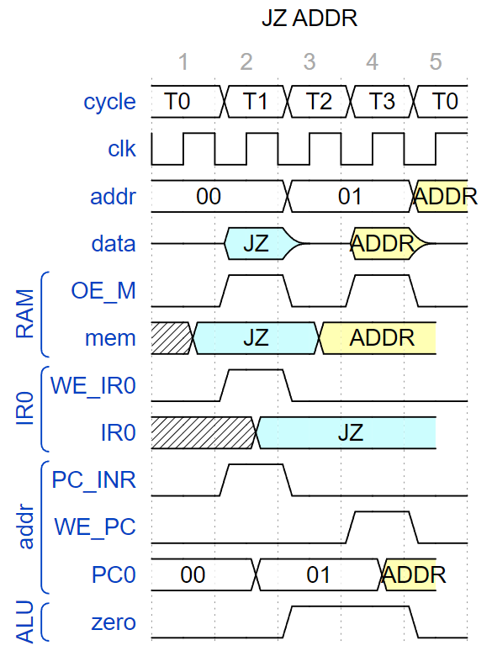
Conditional jump, pass:

Slide 10
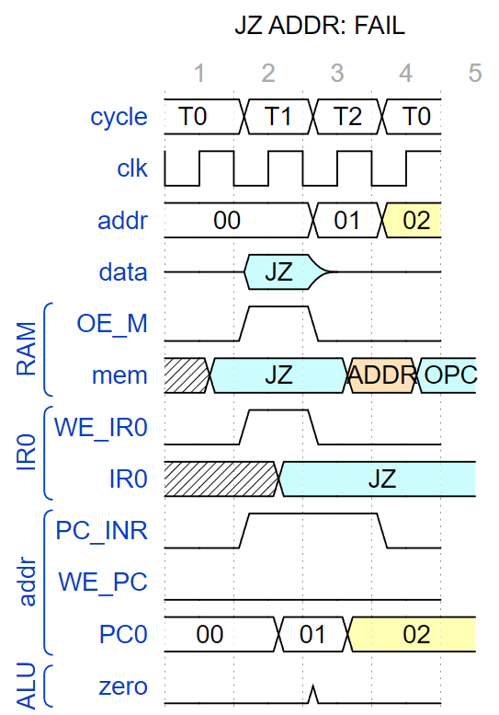
Conditional jump, fail:

Slide 11
Control Unit

Slide 12
RTL Table

